Slide 1
Weekly Progress
Week 15&16

Slide 2
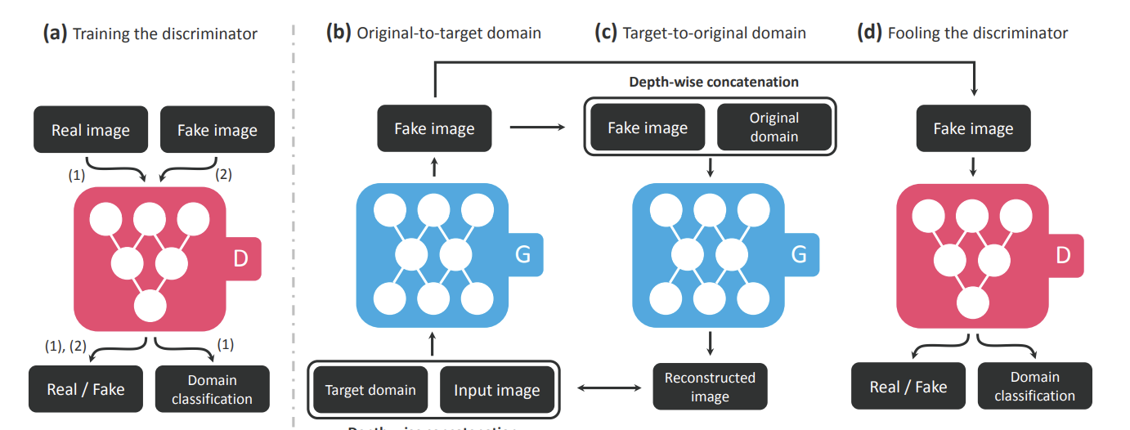
Emotion generator StarGAN
Trainset : RAF dataset with labels such as ‘happy’ and ‘angry’
(a) A discriminator learns to distinguish between real and fake images and classify the real images to its corresponding domain.
(b) Generator takes in as input both the image and target domain label and generates an fake image. The target domain label is spatially replicated and concatenated with the input image.
(c) Generator tries to reconstruct the original image from the fake image given the original domain label.
(d) Generator tries to generate images indistinguishable from real images and classifiable as target domain by a discriminator

Slide 3
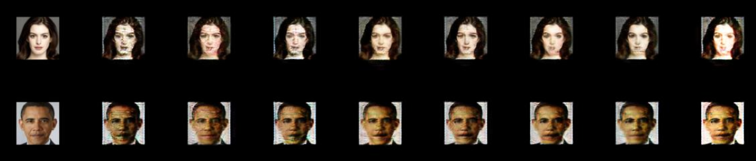
StarGAN Results with random images
TrainSet: RAF Dimension: 8 Train Image size: 128 Iteration: 200,000
Input Angry Contemptuous Disgusted Happy Neutral Sad Fearful Surprised

Slide 4
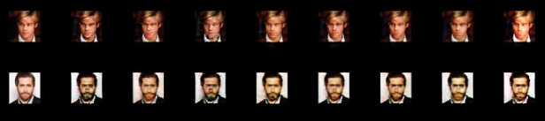
StarGAN Results with random images
TrainSet: RAF Dimension: 8 Train Image size: 128 Iteration: 1,000,000
Input Angry Contemptuous Disgusted Happy Neutral Sad Fearful Surprised

Slide 5
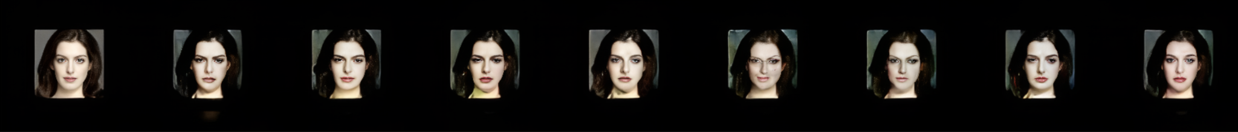
StarGAN Results with random images
TrainSet: AffectNet Dimension: 8 Train Image size: 96 Iteration: 200,000
Input Angry Contemptuous Disgusted Happy Neutral Sad Fearful Surprised

Slide 6
Current Problems with StarGAN
Data set is different from original used in StarGAN
Waiting for approval from Radboud Faces Database
Training used image size of 128*128 however, the input images size are 256*256
It might cause emotion change bad
Tried image pre-processing to resize the images
Image pre-processing makes image quality too bad
It might cause emotion change bad

Slide 7
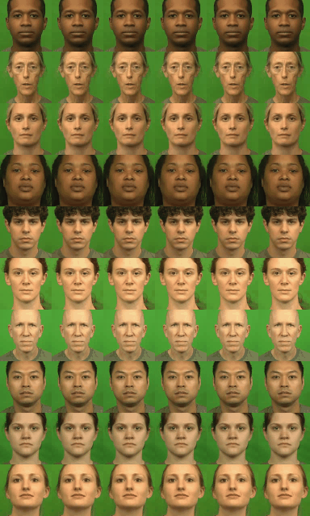
Speech Driven Talking Face Generation from
a Single Image and an Emotion Condition
Each row shows 6 videos created using the same image and speech
but with different emotion input. Columns represent
anger, disgust, fear, happiness, neutral, and sadness, respectively.

Slide 8
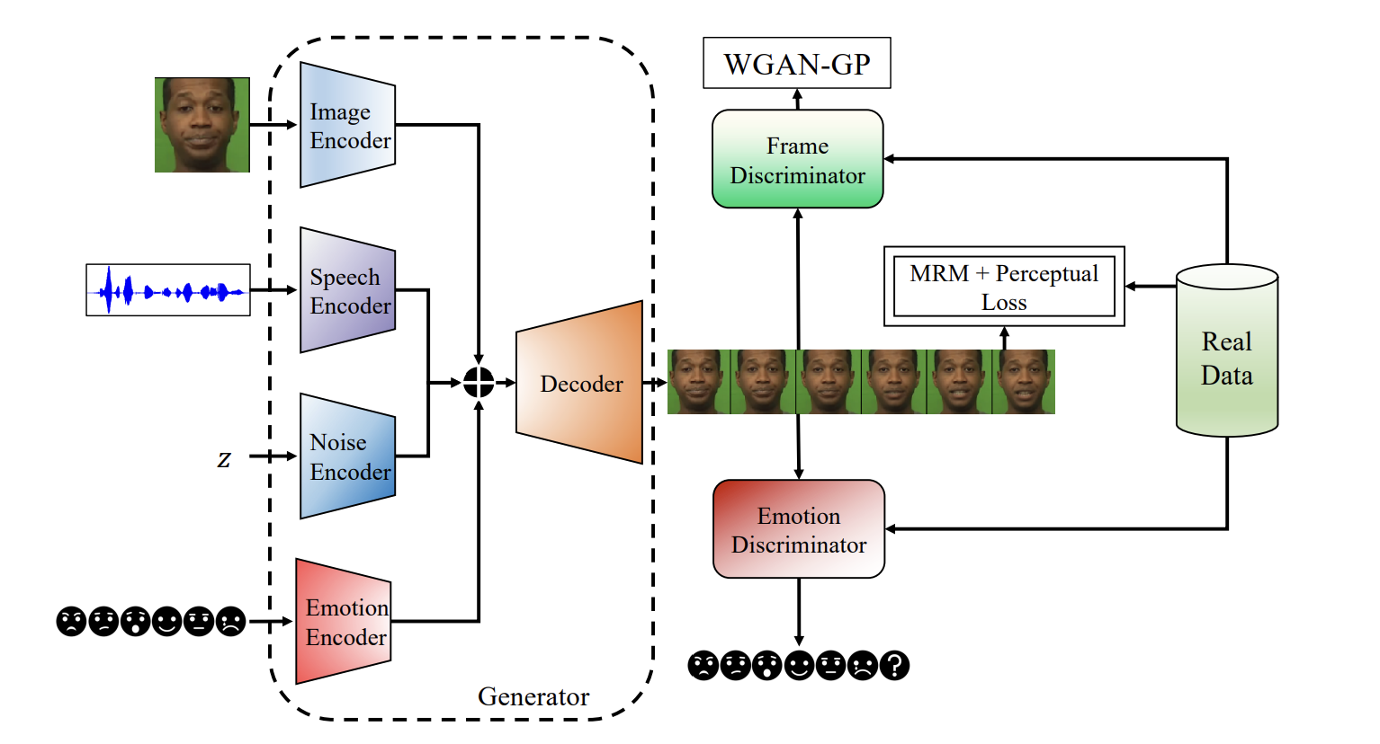
Speech Driven Talking Face Generation Overview
It accepts a reference image, a speech waveform, a random vector from the standard normal distribution, and a categorical emotion as input, concatenates their embeddings, and generates a talking face video that is synchronized with the input speech and expresses the input emotion. During training, besides the MRM reconstruction loss and perceptual loss, the network employs two discriminative losses: the frame discriminator for image quality and the emotion discriminator for emotion expression.

Slide 9
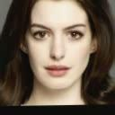
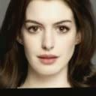
Speech Driven Talking Face Generation Result with Anne
Increased video quality
Disgusted Sad Angry

Slide 10
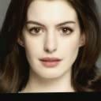

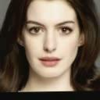
Speech Driven Talking Face Generation Result with Anne
Increased video quality
Happy Neutral Fearful

Slide 11
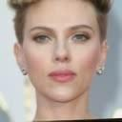
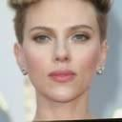
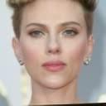
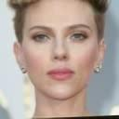
Speech Driven Talking Face Generation Result with Scarlett(compared different audio source)
Disgusted Disgusted_1 Angry Angry_1

Slide 12



Speech Driven Talking Face Generation Result with own photo
Disgusted Sad Angry

Slide 13



Speech Driven Talking Face Generation Result with own photo
Happy Neutral Fearful

Slide 14
Future Plan
Keep working on to improve emotion generator
Frame improvement
Image pre-processing

Slide 15
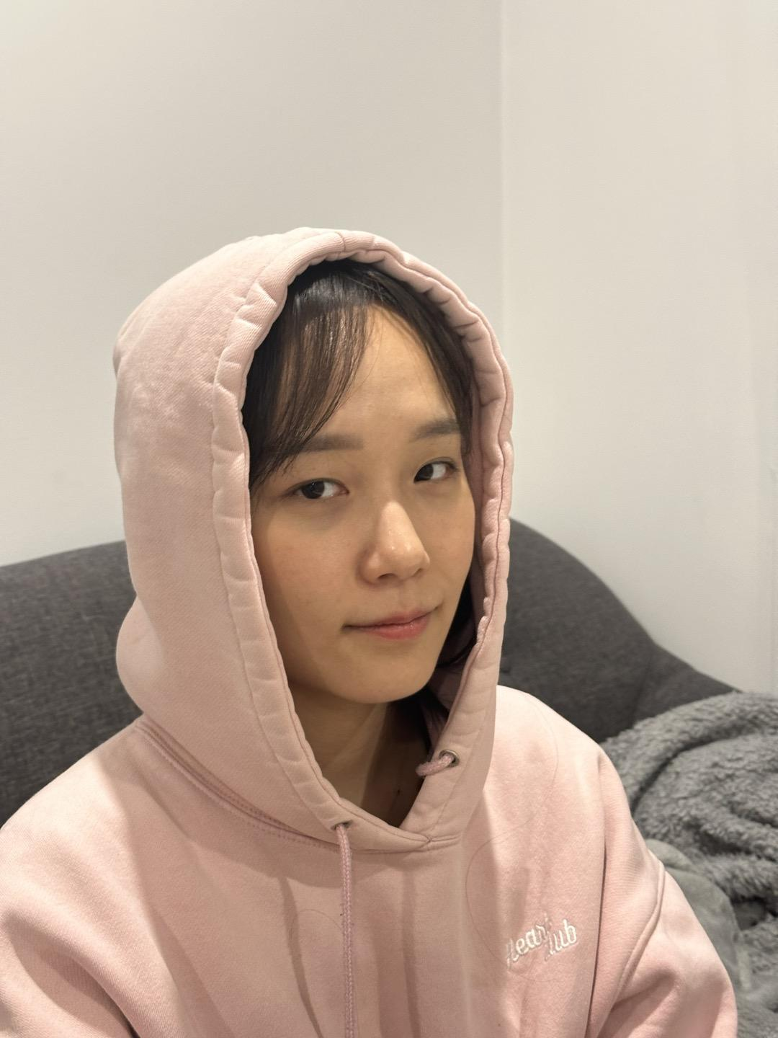
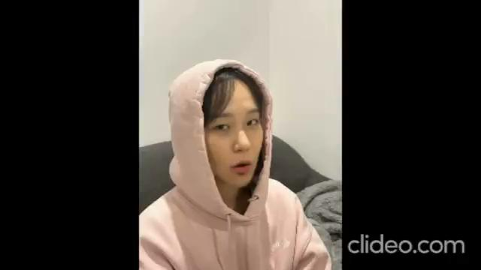
Lip sync- Video retalking with own images (aimed to use images from different angles)
Converted image to video first, then applied
Output
Input

Slide 16


Lip sync- Video retalking with own images
Input
Output

Slide 17
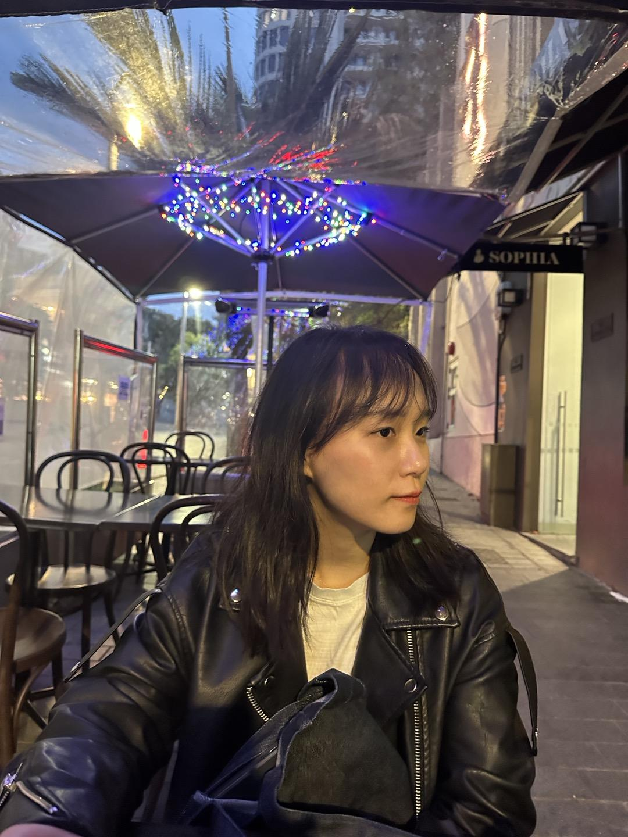
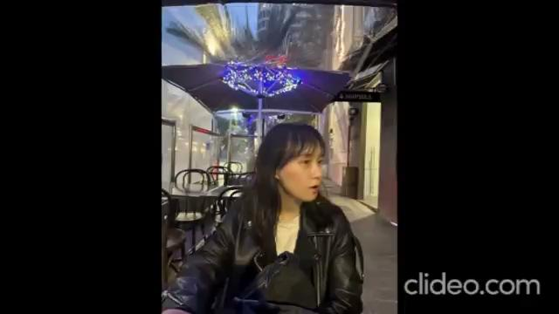
Lip sync- Video retalking with own images
Input
Output

Slide 18
Evaluation metrics (lip synchronisation)
MRE (Mean Relative Error): measure of error between two variables, taking the mean of the absolute differences between the predicted and true values, divided by true values
PSNR (Peak Signal-to-Noise Ratio): measure the quality of the reconstructed image compared to the original image, ratio between the maximum possible pixel value and the value of the distortion caused by reconstruction. (raw pixel values)
SSIM (Structural Similarity Index Measure): considers changes in structural information, pierced visual differences, and luminance.
FID (Frechet Inception Distance): compares similarity of two sets of images, both visual difference and overall variation across each set of images. Uses pre-trained network to extract a set of features then calculates mean and covariance

Slide 19
Converted video to frames first, then applied metrics (calculated average)
 | PSNR (higher) | MSE (lower) | SSIM (higher) | FID (lower)
Wav2lip | 36.236 | 46.699 | 0.963 | 17.459
Last year’s work | 33.791 | 82.680 | 0.945 | 19.609
PC-AVS (without head pose) | 14.985 | 6197.761 | 0.453 | 222.123
Video-retalking | 34.958 | 62.498 | 0.955 | 74.156
Wav2lip+Codeformer | 33.571 | 86.141 | 0.958 | 58.836
Videoretalking+Codeformer | 32.552 | 108.669 | 0.951 | 26.042
As these three metrics are for evaluating the quality of the video, I tried to work on lip sync scores, however, not getting the scores generated. Will come back on this later on (syncnet_python)

Slide 20
Further improvement for lip synchronisation
Video-retalking works pretty well even with the faces from different angles, however, the video resolution is quite low and no face movement is generated with a single image input
As CodeFormer gives a bit distorted result, I was looking for super video resolution code, but as I think generating facial expression is more urgent , putting it on hold for now

Slide 21
GANimation
Extracts AUs (Action units) which are defined set of facial muscle movements that correspond to displayed emotions
Then apply this in the input image

Slide 22
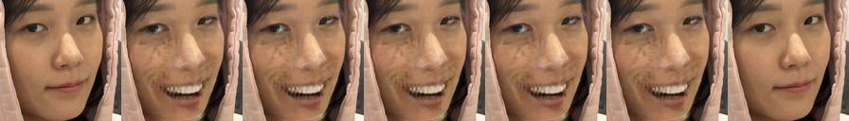
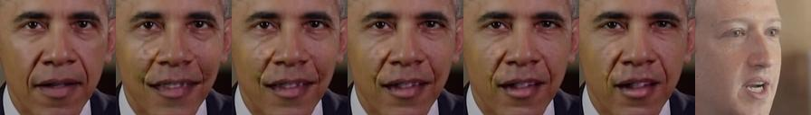
GANimation (for facial expression generation)
CelebA dataset trained with GANimation
Input Target image
Input Target image

Slide 23


GANimation (for facial expression generation)
CelebA dataset trained with StarGAN
Input Target image
Input Target image

Slide 24

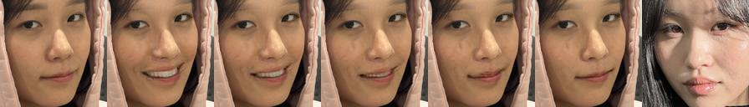
GANimation (for facial expression generation)
EmotionNet dataset trained with GANimation
Input Target image
Input Target image

Slide 25


GANimation (for facial expression generation)
EmotionNet dataset trained with StarGAN
Input Target image
Input Target image

Slide 26
Things to do
Ethics application
Get emotion working
Video resolution
Metrics results

Slide 27
 | PSNR (higher) | MSE (lower) | SSIM (higher) | FID (lower)
Wav2Lip | 36.236 | 46.699 | 0.963 | 17.459
SPT Wav2Lip | 33.791 | 82.680 | 0.945 | 19.609
PC-AVS | 14.985 | 6197.761 | 0.453 | 222.123
Video-retalking | 34.958 | 62.498 | 0.955 | 74.156
Wav2lip+Codeformer | 33.571 | 86.141 | 0.958 | 58.836
Sadtalker+Codeformer | 32.552 | 108.669 | 0.951 | 26.042

Slide 28
 | PSNR ↑ | MSE ↓ | SSIM ↑ | FID ↓
SPT Wav2Lip | 33.791 | 82.680 | 0.945 | 19.609
PC-AVS | 14.985 | 6197.761 | 0.453 | 222.123
Video-retalking | 34.958 | 62.498 | 0.955 | 74.156
Sadtalker+ Codeformer | 32.245 | 53.894 | 0.967 | 18.042

